Slide 1


Data Lakehouse and OneLake

Slide 2
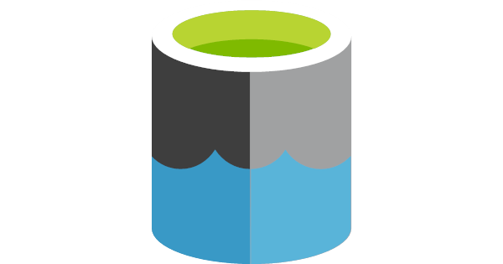
Data Lakehouse

Slide 3
The lakehouse architecture was developed to address key challenges that arose with traditional data lake and data warehouse architectures.
Limitations of Traditional Data Lakes
Limitations of Traditional Data Warehouses
Lack of Schema Enforcement
Poor Data Readability
Low Query Performance
Data Governance issues
Scalability Constraints
High operation costs
Limited Flexibility
A data lake is a centralized repository designed to store large volumes of raw, unprocessed data in its original format.
A data warehouse is a system optimized for storing and querying structured and processed data, primarily for business intelligence (BI) and reporting.

Slide 4
Emergence of New Data Needs
Growth in Unstructured Data: Explosion of data types (e.g., images, audio, video, logs) requires a system that can handle structured, semi-structured, and unstructured data uniformly.
Demand for Real-Time Analytics: Traditional architectures cannot support real-time or near-real-time analytics on large-scale datasets efficiently.
AI/ML Workloads: Data lakes are good for raw data storage but lack the reliability and performance needed for feature engineering and iterative machine learning workflows.

Slide 5
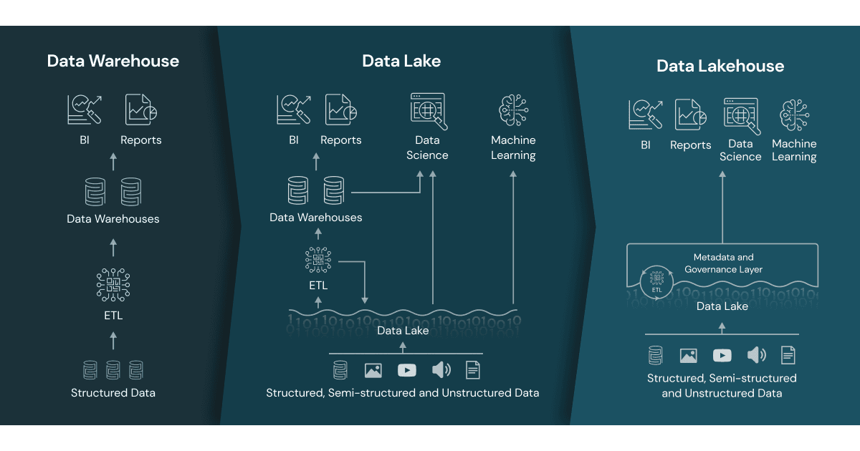

Data Lakehouse
A data lakehouse provides scalable storage and processing capabilities for modern organizations that want to avoid isolated systems for processing different workloads, like machine learning (ML) and business intelligence (BI).
A data lakehouse is a modern data management architecture that combines the best features of data lakes and data warehouses. It provides the scalability and flexibility of data lakes with the data management and transactional capabilities of data warehouse
A data lakehouse can help establish a single source of truth, eliminate redundant costs, and ensure data freshness.
Data lakehouse leverages ADLS for storage while adding robust data management features through Delta Lake, creating a powerful and efficient data platform for various analytics and machine learning workloads.
Delta Lake Integration
Notes:
Storage Foundation: ADLS serves as the underlying storage layer for a data lakehouse. It provides the scalable and cost-effective storage needed to hold large volumes of data.
Delta Lake Integration: On top of ADLS, Delta Lake is often used to add data management capabilities. Delta Lake provides ACID transactions, schema enforcement, and other data management features that enhance the reliability and performance of the data lakehouse.
Unified Data Access: The data lakehouse architecture allows users to access and analyze data stored in ADLS using a single platform, simplifying data workflows and reducing the need for multiple systems
Delta Lake can be considered a bridge between traditional data lakes and data warehouses. By adding data warehouse-like management capabilities to data lakes (like ACID transactions and schema enforcement), Delta Lake transforms a simple data lake into a more robust, reliable, and performance-optimized data platform, which is sometimes referred to as a data lakehouse
Delta lake = data warehouse
Not quite. Although Delta Lake provides some data warehouse-like features, it is not a data warehouse itself. Here's a breakdown:
Delta lake = data warehouse
Not quite. Although Delta Lake provides some data warehouse-like features, it is not a data warehouse itself. Here's a breakdown:
Delta Lake
Purpose: Delta Lake is an open-source storage layer that adds reliability and performance optimizations to data lakes.
Features: It provides ACID transactions, scalable metadata handling, and unified batch and streaming data processing.
Integration: It integrates with big data tools like Apache Spark to enhance the capabilities of a data lake.
Data Warehouse
Purpose: A data warehouse is a system designed for querying and analyzing large volumes of structured data, typically from various sources.
Features: It includes optimized storage, complex querying capabilities, and data transformation functionalities, usually structured in a star or snowflake schema.
Usage: Data warehouses are used for Business Intelligence (BI) and reporting.

Slide 6
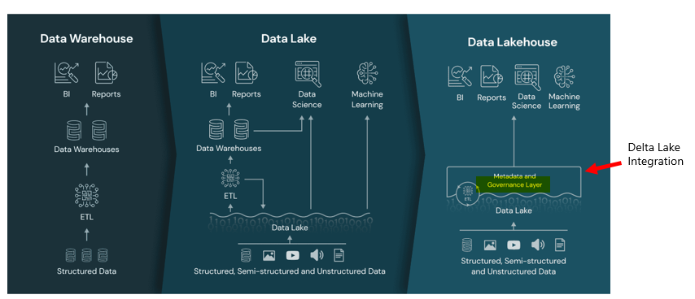
A data lakehouse is a modern data management architecture that combines the best features of data lakes and data warehouses. It provides the scalability and flexibility of data lakes with the data management and transactional capabilities of data warehouses
Key Features of a Data Lakehouse:
Scalability: Like data lakes, it can store vast amounts of structured, semi-structured, and unstructured data.
Data Management: It includes features like ACID transactions, schema enforcement, and data versioning, similar to data warehouses.
Unified Platform: It allows for both batch and real-time data processing, making it suitable for a wide range of analytics and machine learning tasks

Slide 7
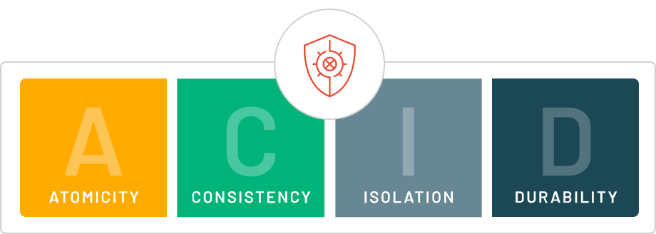
Data becomes your single source of truth
uses cloud object storage to store all data files and transaction logs. Cloud object storage has high availability and durability.
The transaction log controls commit atomicity. During a transaction, data files are written to the file directory backing the table. When the transaction completes, a new entry is committed to the transaction log that includes the paths to all files written during the transaction.
uses write serializable isolation by default for all table writes and updates. Snapshot isolation is used for all table reads.
Delta Lake uses optimistic concurrency control to provide transactional guarantees between writes.
Notes:
By adding data warehouse-like management capabilities to data lakes (like ACID transactions and schema enforcement), Delta Lake transforms a simple data lake into a more robust, reliable, and performance-optimized data platform, which is sometimes referred to as a data lakehouse.

Slide 8
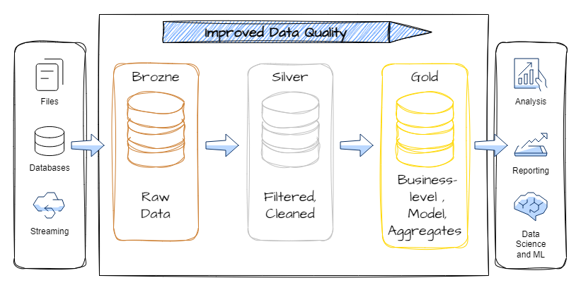
Delta is a term introduced with Delta Lake, the foundation for storing data and tables in the Fabric lakehouse.
Delta Lake was conceived of as a unified data management system for handling transactional real-time and batch big data, by extending Parquet data files with a file-based transaction log for ACID transactions and scalable metadata handling.

Slide 9

OneLake – The OneDrive for all your data!

Slide 10
OneLake is a single, unified, logical data lake for your whole organization. A data Lake processes large volumes of data from various sources.
Like OneDrive, OneLake comes automatically with every Microsoft Fabric tenant and is designed to be the single place for all your analytics data. OneLake brings customers:
1) One data lake for the entire organization
2) One copy of data for use with multiple analytical engines
OneLake focuses on removing these challenges by improving collaboration. Every customer tenant has exactly one OneLake. There can never be more than one and if you have Fabric, there can never be zero. Every Fabric tenant automatically provisions OneLake, with no extra resources to set up or manage.

Slide 11
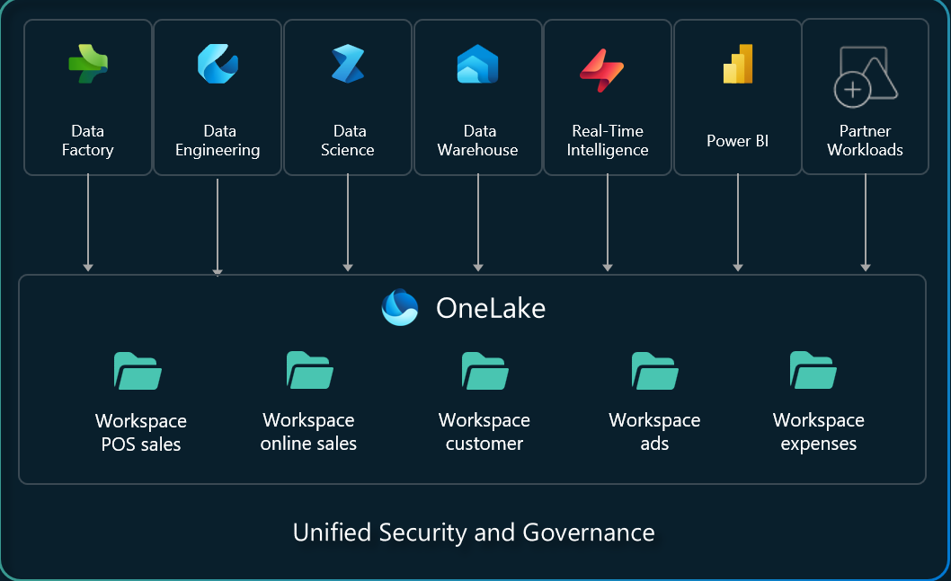
The concept of a tenant is a unique benefit of a SaaS service.
Within a tenant, you can create any number of workspaces. Workspaces enable different parts of the organization to distribute ownership and access policies. Each workspace is part of a capacity that is tied to a specific region and is billed separately.
Similar to how Office stores Word, Excel, and PowerPoint files in OneDrive, Fabric stores lakehouses, warehouses, and other items in OneLake.

Slide 12
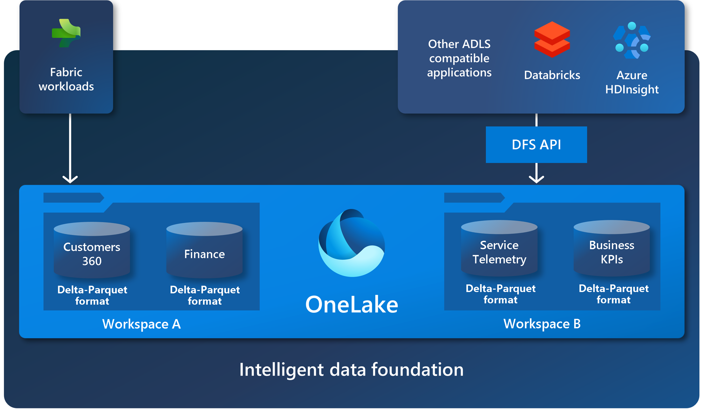
OneLake is “open at every level”
OneLake is built on top of Azure Data Lake Storage (ADLS) Gen2 and can support any type of file, structured or unstructured. All Fabric data items like data warehouses and lakehouses store their data automatically in OneLake in Delta Parquet format
If a data engineer loads data into a lakehouse using Apache Spark, and then a SQL developer uses T-SQL to load data in a fully transactional data warehouse, both are contributing to the same data lake. OneLake stores all tabular data in Delta Parquet format.

Slide 13
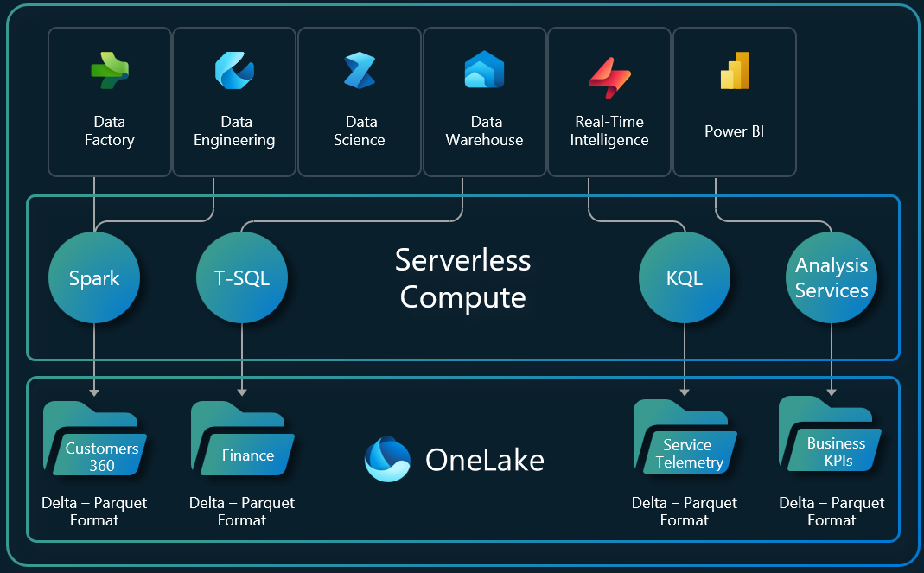
One Copy of Data with Multiple Analytical Engines
With Fabric, the different analytical engines (T-SQL, Apache Spark, Analysis Services, etc.) store data in the open Delta Parquet format to allow you to use the same data across multiple engines.

Slide 14
Final Thoughts
OneLake is the foundational storage platform within Microsoft Fabric, designed to unify data storage across an organization. It integrates the flexibility of data lakes with the reliability and performance of data warehouses, solving key challenges in modern data management.
By addressing the limitations of traditional data lakes and warehouses, OneLake enables organizations to:
Streamline data management processes.
Achieve real-time insights and advanced analytics.
Reduce operational costs and complexity.
Ensure data governance and security at scale.

